Slide 1
The Potential of Federated Learning in Healthcare Settings
Seán Ó Fithcheallaigh

Slide 2
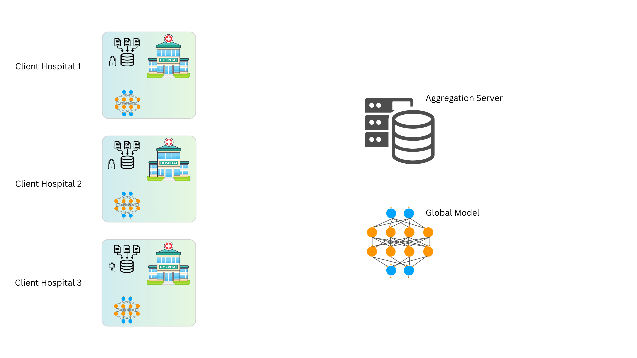
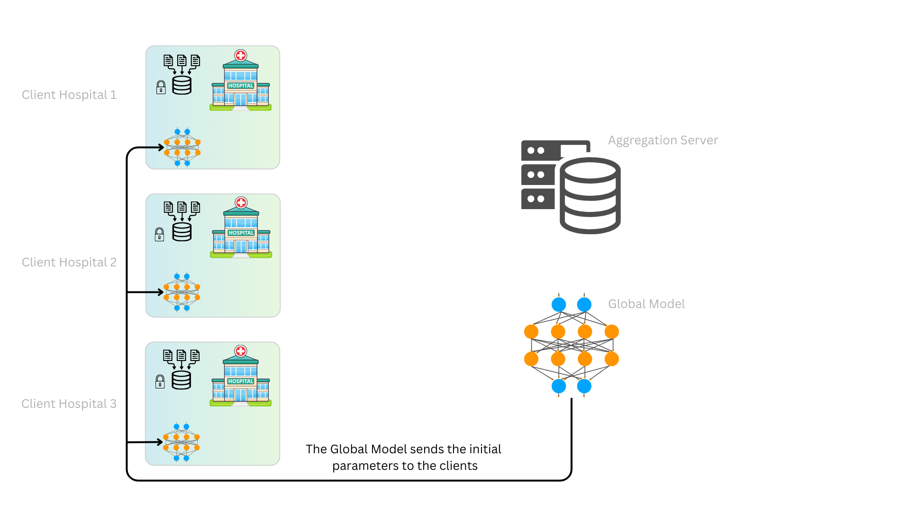
Federated Learning

Slide 3


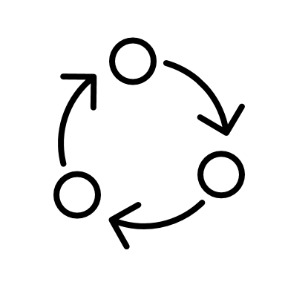
Agenda
Refining Areas of Interest
Prototype Update
Ongoing Work

Slide 4
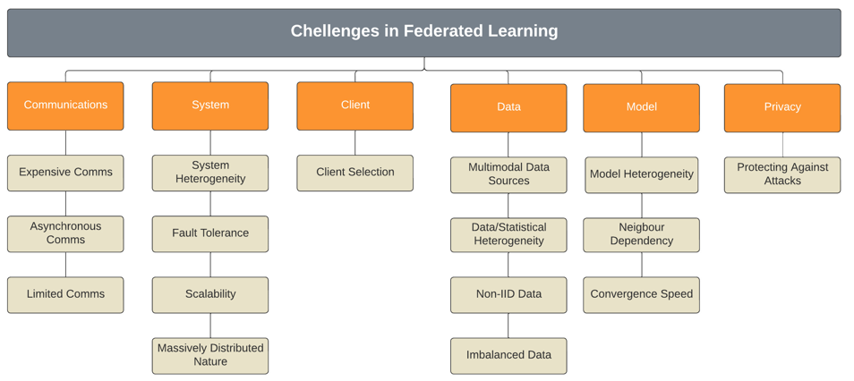
Exploring Challenges in FL
Communication: The link between the server and clients, or between devices
System: The network, when taken as a whole (i.e., sever, clients, etc.)
Client: The remote device or entity which does the local training
Data: The data gathered by the client, which is used for local training
Model: The ML model which is run on the various system elements
Privacy: The need to keep data safe and secure

Slide 5
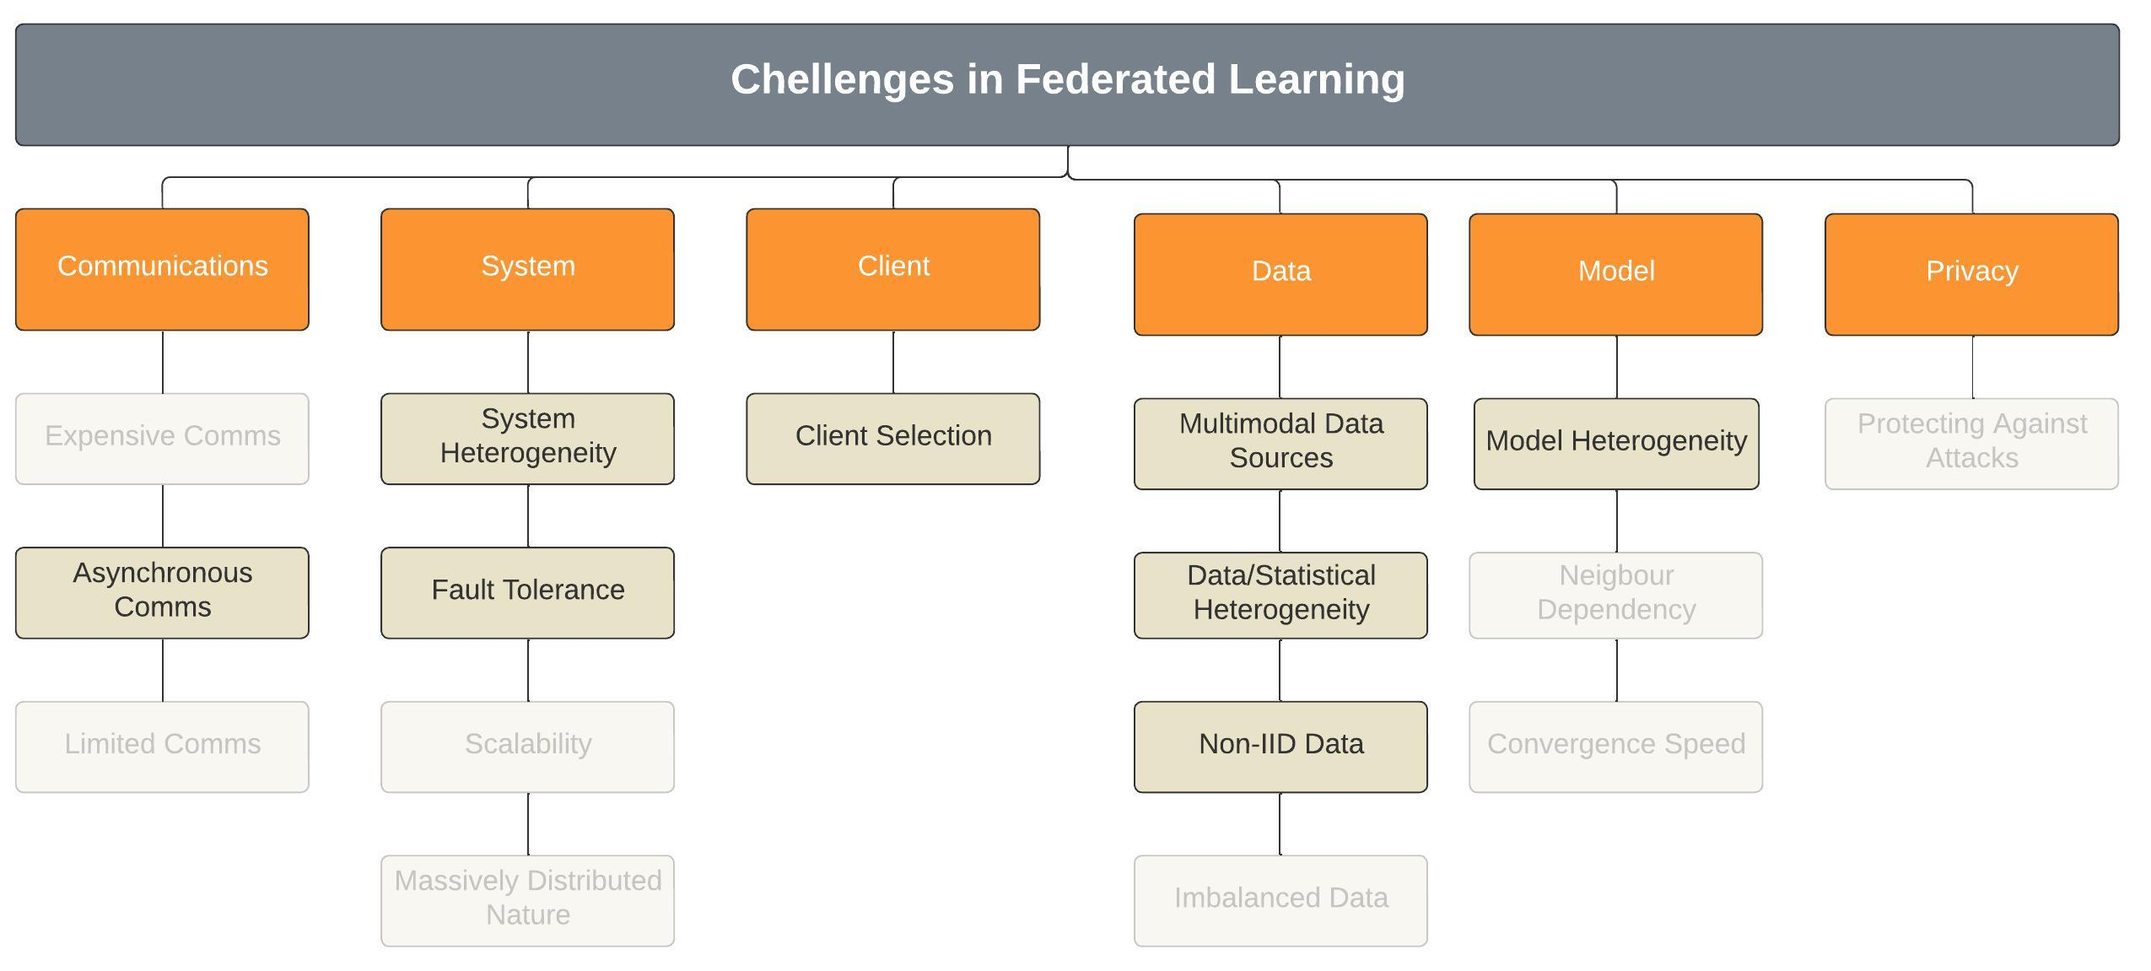
Exploring Challenges in FL: Refining Topics
Communication: The link between the server and clients, or between devices
System: The network, when taken as a whole (i.e., sever, clients, etc.)
Client: The remote device or entity which does the local training
Data: The data gathered by the client, which is used for local training
Model: The ML model which is run on the various system elements
Privacy: The need to keep data safe and secure

Slide 6
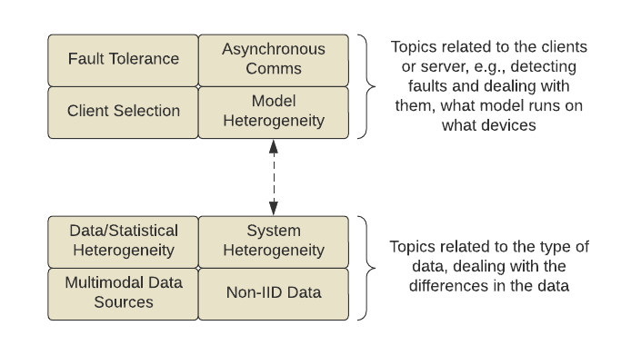
Grouping
The challenges identified seem like they could be related, and as such could be grouped together.
These groups should not be viewed as totally independent, for example, model heterogeneity and system heterogeneity are related through the idea that different clients could run different model, and so on
Further reading required around these topics

Slide 7
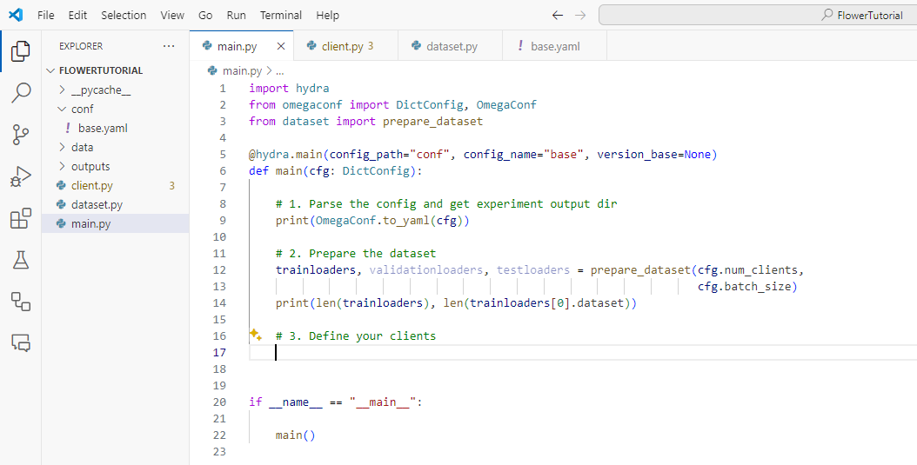

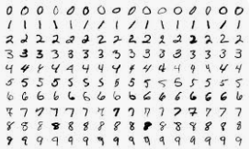
Prototype Build: Flower
I am currently working through the tutorials on Flower. Using the Flower framework
Provides understanding of TensorFlow and PyTorch
Allows for a greater understanding of how FL networks are coded
Provides a range of datasets for FL work
Current work is using the MNIST dataset, which is split between 100 clients

Slide 8
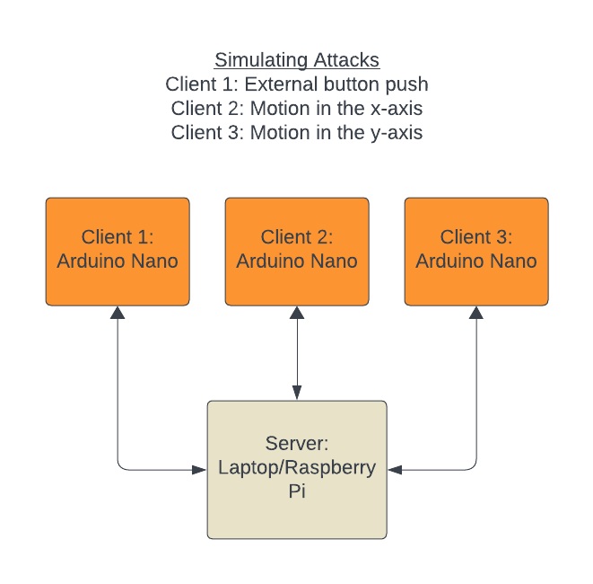
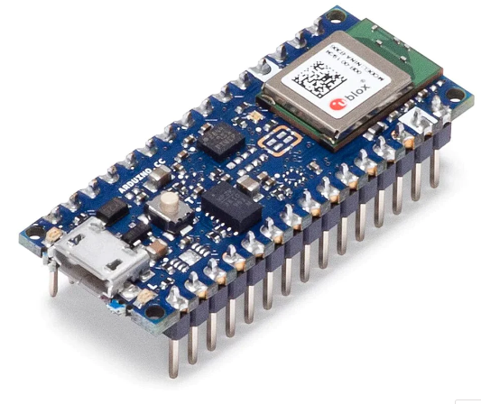
Prototype Build: Arduino
Development of a TinyFL project used to simulate detecting network intrusions.
The system would have several Arduino Nano dev kits acting as clients and a laptop or Raspberry Pi as a server
The sensors on a specific dev kit will be used to represent a specific type of intrusion
External button push on Client 1 representing Intrusion Type 1
Accelerometer threshold in x-axis exceeded on Client 2 representing Intrusion Type 2
Accelerometer threshold in y-axis exceeded on Client 3 represents Intrusion Type 3
Full system tested after client models are trained to understand performance

Slide 9
Ongoing Work
Continue the work using the Flower framework
Completing tutorials
Continue reading articles, especially those with a focus on
Fault tolerance/detection
Reliability within FL
Multimodal data
As well as reading, start trying to understand who are the main researchers or groups working in these areas
Start building Arduino intrusion detection simulator.
NIBES presentation (2 slides max.)
Reformatting MSc paper for UKCI 2024

